Slide 1
Technical Support (420-1N6-AB) Data Representation
Fall 2022

Slide 2
Outline
Binary System
Representing Numbers in Binary
Representing Negative Numbers in Binary
Representing Text in Binary
Hexadecimal Numbers
Boolean Logic & Logical Gates
Binary Math

Slide 3
The Binary System
Everyone “knows” that computers use “binary” to operate
But, as we saw last class, computers don’t “know” anything -- ultimately, its CPU is just configured to react in particularly sophisticated ways when its switches (the lightbulbs) are turned on or off
So what is binary anyway? And what does it have to do with computers?

Slide 4
The Binary System
In order to understand the Binary numeral system, we can compare it to something we already know: the Decimal numeral system.
In decimal, numbers are represented by combinations of ten different symbols: (0, 1, 2, 3, 4, 5, 6, 7, 8, 9). We call decimal a base 10 numeral system.
If we have more than “9” of something, another digit is needed:
9 + 1 = 10
99 + 1 = 100, etc.
How do we represent numbers in binary?

Slide 5
The Binary System
In binary, there are only two symbols (0, 1). We call binary a base 2 numeral system. So if we have more than “1” of something, another bit is needed:
1 + 1 = 10 (in english: one plus one equals two)
11 + 1 = 100 (in english: three plus one equals four)
It’s counterintuitive at first! But there’s nothing fundamentally different about binary than decimal -- we’re just more used to using decimal instead.

Slide 6
The Binary System
Since we’re reusing symbols from the decimal system, there is a convention to use subscript to disambiguate between different numeral systems
1₂ + 1₂ = 10₂ is the same as 1₁₀ + 1₁₀ = 2₁₀ is the same as one plus one equals two
11₂ + 1₂ = 100₂ is the same as 3₁₀ + 1₁₀ = 4₁₀ is the same as three plus one equals four
This is not always required, but can be useful when the numeral systems are mixed in the same context.

Slide 7
The Binary System
Note: binary and decimal are not the only possible numeral systems. All that distinguishes numeral systems is the number of symbols you agree to use to represent numbers -- there are infinite possible numeral systems!
Hexadecimal is another useful numeral system (16 symbols, or base 16) which we will discuss later

Slide 8
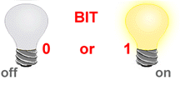
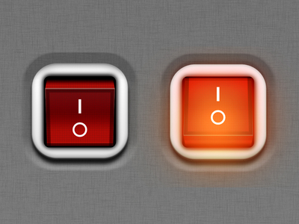
BIT – BInary digiT
So what does Binary have to do with computers?
Bit (Binary Digit) is the basic unit of information representing one of two discrete states.
The smallest unit of information within the computer.
Bit has one of two values:
0 (off) or 1 (on)
0 (False) or 1 (True)

Slide 9
How are Bits Represented in a Computer?
A transistor that is switched on or off
A capacitor that is charged or discharged.
On magnetic disks bits are represented by direction of the magnetic field (N-S, S-N).
Optical discs store bits optically (a bit on the surface is either shiny or not shiny).
Data is transmitted over telephone line or radio link using high- and low-pitched tones.
0
1
1
0
1
0
0
0
1
0
1
1
0
1
0
1

Slide 10
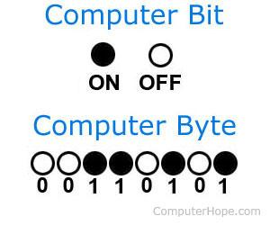
Byte
A Byte is a collection of bits known as the unit of digital information.
1 Byte = 8 bits
Abbreviation: B

Slide 11
Byte History
The byte represents the number of bits used to encode one character in a computer and hence it is the smallest addressable unit of memory in several computer architectures.
Size of a byte has been hardware dependent and no definitive standards existed that mandated the size.
A standard was introduced in 1993 that is common now.
1 byte = 8 bits

Slide 12
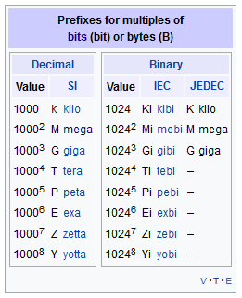
Byte Sizes
1 byte (B)
Kilobyte (KB) = 1,024 bytes (2¹⁰)
“one thousand bytes”
1,024 = 2 * 2 * 2 * 2 * 2 * 2 * 2 * 2 * 2 * 2
Megabyte (MB) = 1,048,576 bytes (2²⁰)
“one million bytes”
Gigabyte (GB) = 1,073,741,824 bytes (2³⁰)
“one billion bytes”
https://en.wikipedia.org/wiki/Byte

Slide 13
Representing Numbers in Binary

Slide 14
Converting Binary to Decimal
Converting binary to decimal is easy to memorize for small numbers. For example:
Binary | Decimal
0 | 0
1 | 1
10 | 2
11 | 3
100 | 4
101 | 5
110 | 6

Slide 15
Converting Binary to Decimal
What about larger numbers? How can we approach this problem systematically, i.e., use a defined method to confidently get the correct answer every time?
Binary | Decimal
1001
1101101
1000001
1111111
100000011000001

Slide 16
Converting Binary to Decimal
Well, how do we do it for decimals? A large number, like 2608, is in fact the combination of multiples of powers of ten. When we say these numbers in English, we naturally decompose the number into its component parts:
2608 is two thousand, six hundred, and eight.
Or, in other words:
2608 = 2 x 10³ + 6x10² + 0x10¹ + 8x10⁰
We can use this exact method, with one key difference, to decompose the value of binary numbers just like decimal numbers.
What key difference? (powers of 2 instead of powers of 10)

Slide 17
Converting: Binary to Decimal
Find the power of 2 value for each bit of the binary number, starting from 0. (e.g., the power of 2 value for the 5th bit of a binary number is: 2⁵=32, etc.)
Add all the powers of two wherever there is a 1 in the bit of the binary number
The sum of the powers of two above is the value of the binary number in decimal!
Binary Number | 1 | 1 | 0 | 0 | 1
Step 1 | 4 | 3 | 2 | 1 | 0
Step 2 | 2⁴ | 2³ | 2² | 2¹ | 2⁰
 | 16 | 8 | 4 | 2 | 1
Step 3 | 16 + 8 + 1 = 25

Slide 18
Exercise: Converting Binary to Decimal
Convert the following binary numbers to decimal:
1001
1101101
1000001
1111111
100000011000001

Slide 19
Converting Decimal Number to Binary
Going the other way (from Decimal to Binary) is a bit less natural -- we cannot “see” directly from the decimal representation of a number (like 2608, for instance), how many powers of two are needed to make the equivalent number in binary.
Instead, we’ll learn an algorithm (a series of deterministic steps to solve an analytical problem)
Divide the decimal number by 2 using long division.
Note down the outcome and remainder of the division on the side.
Repeat steps 1 and 2 on the outcome until the outcome becomes zero.
The binary number will be the series of the remainders in the step 2
While it may seem like a random series of steps, there is a good reason why it works (can you think of why?). It is best to try some examples first to get the hang of it.

Slide 20
Demo: Converting Decimal Number to Binary
Covert 25 to binary.
Long Division (divide the Outcome by 2 at every step):
Outcome | Remainder
25 | 1
12 | 0
6 | 0
3 | 1
1 | 1
0
(25)₁₀ = (11001)₂

Slide 21
Exercise: Converting Decimal Number to Binary
Convert 107 to binary.
Outcome | Remainer
107
double check you have the correct answer! google “107 in binary”

Slide 22
Exercises: Converting Decimal to Binary
Convert the following into binary:
10
64
128
146
300

Slide 23
How many Numbers can I represent?
1 bit -> can represent 2 numbers
(0)₂ = (0)₁₀
(1)₂ = (1)₁₀
2 bits -> can represent 4 numbers
(00)₂ = (0)₁₀
(01)₂ = (1)₁₀
(10)₂ = (2)₁₀
(11)₂ = (3)₁₀
Values: 0 to 3 in decimal.

Slide 24
n Bits ⬄ How many Numbers
Exercise
How many numbers can I represent in 4 bytes? What is the first and last number?
n bits
-> Can represent 2^{n} numbers
-> Values: from 0 to (2^{n} -1)
1 Byte -> 8 bit -> 2⁸ numbers (256)
First Number 0000 0000₂ = (0)₁₀ to
Last Number 1111 1111₂ = 2⁸-1 = (255)₁₀

Slide 25
Binary Math & Representing Negative Numbers

Slide 26
Decimal Math: Addition
10,000’s 1,000’s 100’s 10’s 1’s
1 6 5 1 0
+ 1 6 5 9 5
-----------------------------
3 3 1 0 5
1 1 1

Slide 27
Binary Math: Addition
64’s 32’s 16’s 8’s 4’s 2’s 1’s
1 1 1 0 1 0
+ 1 1 0 1 1
-----------------------------
1 0 1 0 1 0 1
Double check using the decimal numbers.
Dec
58
+ 27 -------
85
1 1 1 1

Slide 28
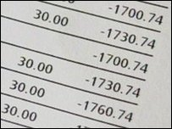

Negative Numbers
Not all numbers are positive.
Winter weather temperatures in Canada ☹
Bank accounts … ☹☹☹
Computers need to represent both positive and negative numbers.

Slide 29
Negative Numbers
In computers, an integer number is represented using
32 bits (4 bytes)
32 bits can represent: 2³² - 1 = 4,294,967,295 numbers
Most computers use the first bit for the sign:
1 for negative
0 for positive
Use the remaining 31 bits for the number itself

Slide 30
Simple Way
32 bits
1 bit for the sign
31 bits = 2³¹ - 1 = 2,147,483,648 numbers
Example:
Decimal Binary
173 00000000 00000000 00000000 10101101
-173 10000000 00000000 00000000 10101101

Slide 31
Simple Way: Representation with 4 bits
There are some problems with the “Simple Way”, however....
What happens when we do math?
( 5 )
+ ( -5 )
-----------
( 6 )
+ ( -2 )
-----------
1 1 1 1 -7
1 1 1 0 -6
1 1 0 1 -5
1 1 0 0 -4
1 0 1 1 -3
1 0 1 0 -2
1 0 0 1 -1
1 0 0 0 -0 Negative zero??
0 0 0 0 0 Zero appears twice!
0 0 0 1 1
0 0 1 0 2
0 0 1 1 3
0 1 0 0 4
0 1 0 1 5
0 1 1 0 6
0 1 1 1 7

Slide 32
Fixing the “Simple” Method: Two’s Complement
Two’s complement is another way computers represent negative numbers.
Basic idea:
we still use the left-most bit to indicate whether a number is positive (0) or negative (1)
BUT: we convert the rest of the bits into the “complement” (negative image) of the positive number. For reasons that have to do with “set theory” (i.e. not important for this class), we will be able to perform normal mathematical operations we would expect to do with negative numbers.

Slide 33
Fixing the “Simple” Method: Two’s Complement
Process: how to represent (-5)₁₀ in binary using two’s complement:
Find the binary value for the positive value of the given number, using all the bits made available to us (so if there is one byte, use all 8 bits)
(5)₁₀ = (0000 0101)₂
Invert all the bits in step 1:
0000 0101 -> invert -> 1111 1010
Add 1 to the inverted value
Inverted binary = 010 + 1 -> (-5)₁₀ = (1111 1011)₂

Slide 34
Two’s Complement: Representation with 4 bits
1 0 0 0 -8
1 0 0 1 -7
1 0 1 0 -6
1 0 1 1 -5
1 1 0 0 -4
1 1 0 1 -3
1 1 1 0 -2
1 1 1 1 -1
0 0 0 0 0
0 0 0 1 1
0 0 1 0 2
0 0 1 1 3
0 1 0 0 4
0 1 0 1 5
0 1 1 0 6
0 1 1 1 7
Let’s do some math operations:
( 5 )
+ ( -5 )
-----------
( 6 )
+ ( -2 )
-----------

Slide 35
Two’s Complement: Representation with 4 bits
1 0 0 0 -8
1 0 0 1 -7
1 0 1 0 -6
1 0 1 1 -5
1 1 0 0 -4
1 1 0 1 -3
1 1 1 0 -2
1 1 1 1 -1
0 0 0 0 0
0 0 0 1 1
0 0 1 0 2
0 0 1 1 3
0 1 0 0 4
0 1 0 1 5
0 1 1 0 6
0 1 1 1 7
Let’s do some math operations:
( 5 ) -> 0101
+ ( -5 ) -> 1011
---------------
-> (1)0000 = 0 (we drop the last 1 which carried over)
( 6 ) -> 0110
+ ( -2 ) -> 1110
----------- -> (1)0100 = 4

Slide 36
More detail about Twos Complement
What if we end up with a negative result? E.g.: How to calculate 4 + (-20) in binary? [FULL SOLUTION]
How to do these problems in general
Review: how many bits do we need to represent a number?
Similar exercises [For you to complete in class. Similar problems on assignment 1 and test 1]

Slide 37
How do we calculate 4 + (-20) in binary?
Steps
Convert 4 and 20 to binary
Apply Two’s Complement rule to (-20)
Add the two binary numbers
IF THE ANSWER IS NEGATIVE
Apply Two’s Complement rule to the answer (this will flip it to a positive number)
Convert to decimal to check your answer

Slide 38
How do we calculate 4 + (-20) in binary?
Step 1. Convert 4 and 20 to binary
Steps | Outcome | Remainder
1 | 4 | 0
2 | 2 | 0
3 | 1 | 1
Stop | 0
(4)₁₀ = (100)₂
Steps | Outcome | Remainder
1 | 20 | 0
2 | 10 | 0
3 | 5 | 1
4 | 3 | 0
5 | 1 | 1
Stop | 0
(20)₁₀ = (10100)₂

Slide 39
How do we calculate 4 + (-20) in binary?
Step 2: Apply Two’s Complement to 20₁₀ (10100)₂
Ask yourself: do I have enough bits?
Rule of thumb: if left most bit is “1” and your number is supposed to be positive, add an extra bit! (because negative numbers should always start with 1, and positive numbers should always start with a 0)
(20)₁₀ = (10100)₂ -> (010100)₂
Invert all the bits in step 1:
010100 -> invert -> 101011
Add 1 to the inverted value
101011 + 1 = 101100
therefore, (-20)₁₀ = (101100)₂

Slide 40
How do we calculate 4 + (-20) in binary?
Step 2: Apply Two’s Complement to 20₁₀ (10100)₂
NOTE: you can add as many bits as you like! Adding zero to the left hand side of a number never changes its value. Let’s say we used 8 bits instead of 6. We would get:
(20)₁₀ = (10100)₂ -> (00010100)₂ 00010100 -> invert -> 11101011 11101011 + 1 = 11101100
therefore, (-20)₁₀ = (11101100)₂ (this is actually the same as the result on the previous slide, just with two extra 1s at the left hand side).

Slide 41
How do we calculate 4 + (-20) in binary?
Step 3: Add the two binary numbers
0 0 0 1 0 0 (use the same number of bits for both numbers!)
+ 1 0 1 1 0 0
-------------------------------
1 1 0 0 0 0

Slide 42
How do we calculate 4 + (-20) in binary?
Step 4: Check your answer
110000₂ is a negative number (begins with ‘1’) -- so first let’s apply the
Two’s Complement rule to make it positive again.
Invert all the bits:
110000 -> invert -> 001111
Add 1 to the inverted value 001111 + 1 = 010000
Convert to decimal
010000 = 2⁴ = 16
This means we correctly calculated: 4 - 20 = -16 [end of solution]

Slide 43
How do we calculate 4 + (-20) in binary?
Steps (Review)
Converting 4 and 20 to binary
Apply Two’s Complement rule to (-20)
How many bits do we need to represent -20? Rule of thumb: since left most bit of 20 is a “1”, add an extra bit!
Add the two binary numbers
Important: use all of the bits from step 2 for both numbers
Check your answer: convert the result to decimal
Trick: if the answer is negative, apply Two’s Complement rule again before converting to decimal

Slide 44
How to do these problems in general?
Steps (no matter what the numbers are)
Convert from decimal to binary
Apply Two’s Complement rule to all negative numbers
Important: choosing the right number of bits to use. Rule of thumb: if left most bit is a 1, add an extra bit
Add the two binary numbers
Important: use all of the bits from step 2
Check your answer: convert the result to decimal
Trick: if the answer is negative, apply Two’s Complement rule again before converting to decimal

Slide 45
Review: How many bits do we need to represent a number?
1 bit -> can represent 2 unsigned numbers
(unsigned: no distinction between positive and negative)
(0)₂ = (0)₁₀
(1)₂ = (1)₁₀
2 bits -> can represent 4 unsigned numbers
(00)₂ = (0)₁₀
(01)₂ = (1)₁₀
(10)₂ = (2)₁₀
(11)₂ = (3)₁₀
Values: 0 to 3 in decimal.

Slide 46
Review: n Bits ⬄ How many Numbers
Check your understanding -- please ask your classmates and/or MIO me if you don’t know the answers to these questions!
How many unsigned numbers can I represent in 4 bytes? How many signed numbers can I represent?
n bits
Can represent 2^{n} numbers
Values: from 0 to (2^{n} -1)
1 Byte -> 8 bit -> 2⁸ numbers (256)
First Number 0000 0000₂ = (0)₁₀ to
Last Number 1111 1111₂ = 2⁸-1 = (255)₁₀

Slide 47
Review: Two’s Complement: Representation with 4 bits
1 0 0 0 -8
1 0 0 1 -7
1 0 1 0 -6
1 0 1 1 -5
1 1 0 0 -4
1 1 0 1 -3
1 1 1 0 -2
1 1 1 1 -1
0 0 0 0 0
0 0 0 1 1
0 0 1 0 2
0 0 1 1 3
0 1 0 0 4
0 1 0 1 5
0 1 1 0 6
0 1 1 1 7
How many signed numbers can we represent with 4 bits in Two’s complement?
Still the same magnitude (4 bits -> 2⁴ total numbers)
But: the values you can represent are approximately halved (because half of the numbers you’re representing are now negative!)
So instead of 0 -> 15 (unsigned)
We now have -8 -> 7 (signed)

Slide 48
Exercises: To Complete in Class (hand in your progress by end of class)
Questions 1. What is 22 - 3?
2. What is 32 - 8?
3. What is 14 - 17?
4. What is 6 - 30?
Steps (show your work for each step!)
Convert from decimal to binary
Apply Two’s Complement rule to all negative numbers
Add the two binary numbers
Check your answer: convert the result to decimal

Slide 49
Representing Text

Slide 50
Text in Computers
In early years, different computer companies applied the binary system in their own way.
The word “cat” would be encoded in binary different on different brands of computers.
This made life difficult in terms of being able to transfer data from one system to another.

Slide 51
ASCII
ASCII (American Standard Code for Information Interchange)
Standard introduced that used a 7 bit code with 128 combinations.
Later became 8-bits (256 combinations) – ASCII-8.
Why eight bits?
So each character can be stored in a single byte.
CAT 0100 0011 0100 0001 0101 0100
cat 0110 0011 0110 0001 0111 0100

Slide 52
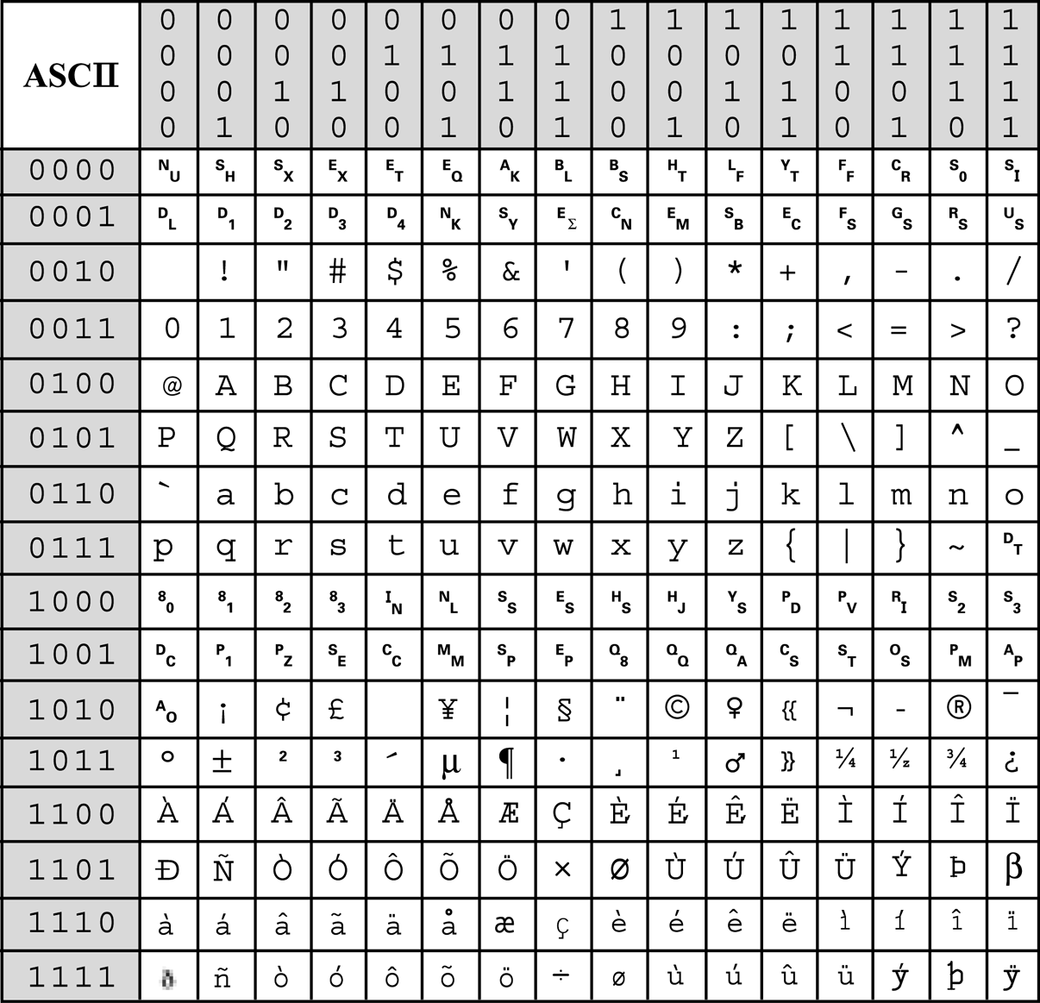
ASCII-8
0 0 1 1
Decode the following message
0100 0001 0101 0011 0100 0011
0100 1001 0100 1001 0010 0000
0110 1001 0111 0011 0010 0000
0110 1100 0110 1001 0110 1101
0110 1001 0111 0100 0110 0101
0110 0100

Slide 53
ASCII-8
0 0 1 1
A S C I I (space)
i s (space)
l i m i t e d

Slide 54
Unicode
Although ASCII works fine for English, many other languages need more than 256 characters, including numbers and punctuation.
Unicode is a computing industry standard for the consistent encoding, representation, and handling of text expressed in most of the world's writing systems and operating systems.
The Unicode standard defines UTF-8, UTF-16, and UTF-32, and several other encodings are in use.

Slide 55
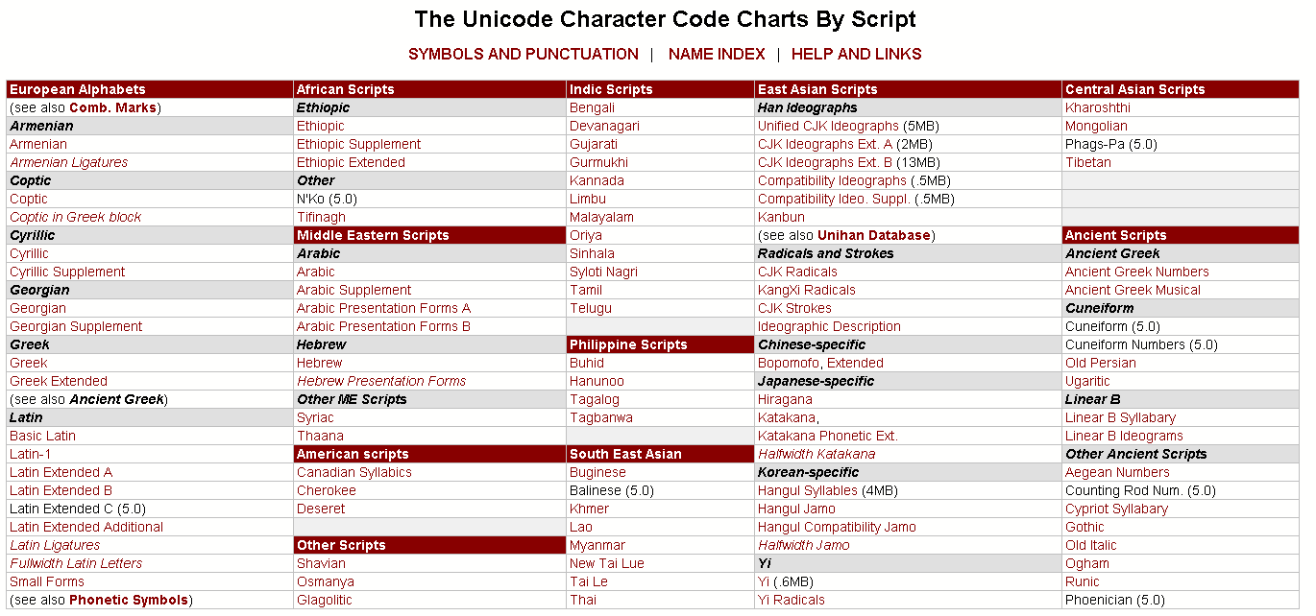
Unicode

Slide 56
Boolean Logic & Logic Gates

Slide 57
Boolean Operations
Integrated Circuits (microchips) are used to store and manipulate (process) bits.
Bits can be manipulated using Boolean Operations.
Boolean algebra: the mathematics of digital logic and Boolean operations.
Name Boolean for mathematician George Boole
Useful in dealing with binary systems where a variable can have a false of 0 or 1 (true or false).
Uses Boolean operations to manipulate one or more Boolean values.
Used in the analysis and synthesis of logical expressions.

Slide 58
Logic in Electronics
Electrical circuits are designed to represent logical expressions
Known as logic circuits.
Used to make important logical decisions in household appliances, computers, communication devices, traffic signals and microprocessors.
Four basic logic operations listed below:
OR operation
AND operation
NOT operation
XOR operation (eXclusive Or)

Slide 59
Logic Gates
A logic gate is an electronic circuit/device which makes the logical decisions based on these operations.
Logic gates have:
One or more inputs
Only one output
Computes a Boolean operation.
The output is active only for certain input combinations.
Logic gates are the building blocks of any digital circuit.

Slide 60
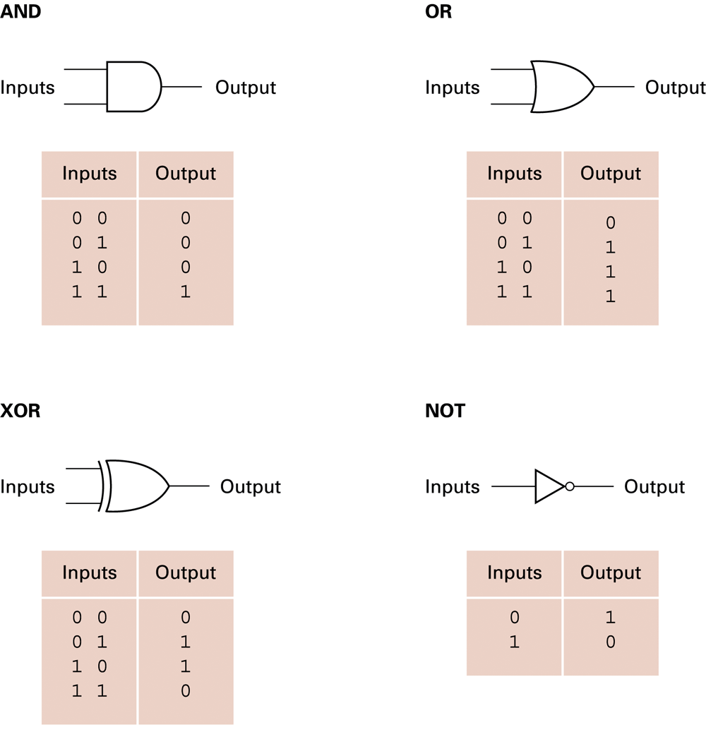
Logic Gate & Truth Tables
Using Truth Tables we can use different sets of logic operations to store, add, subtract, and perform more complicated operations with bits.

Slide 61
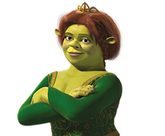
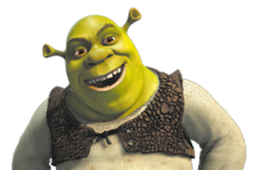
Boolean Operations: AND
TRUE
TRUE
AND
=TRUE
AND Operation
Both input values must be TRUE for output to be TRUE
Shrek is an ogre AND Fiona is a princess
Both inputs are TRUE, so the output is TRUE

Slide 62


Boolean Operations: AND Gate
Truth Table
Inputs Outputs
0 0 0
0 1 0 0 = FALSE
1 0 0 1 = TRUE
1 1 1
AND Operation
Both input values must be TRUE for output to be TRUE
0
0
0
0
0
1
1
0
0
1
1
1

Slide 63
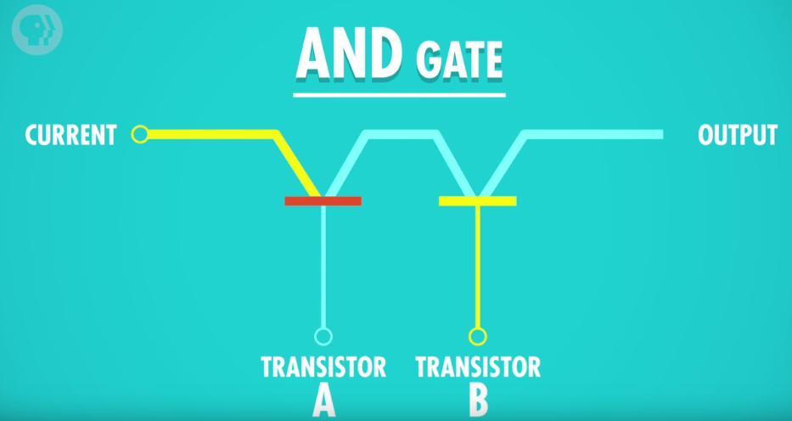
AND Gate
To build an AND gate: Two transistors connected together
Two inputs (transistors A and B) and one output
Transistor A: Off (False)
Transistor B: On (True)
Output: Off (False)
Off (False)
Off (False)
On (True)

Slide 64
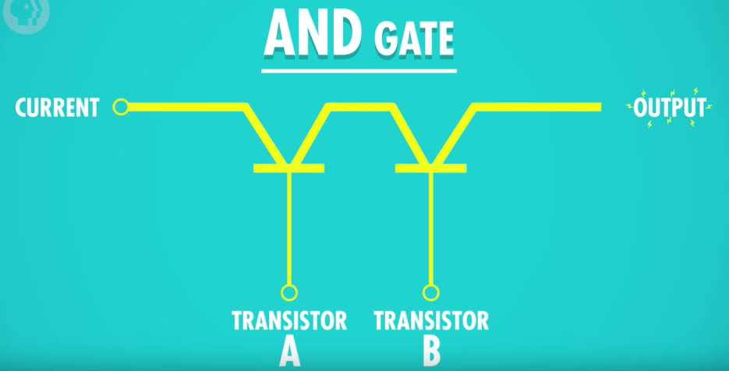
AND Gate
Transistor A: On (True)
Transistor B: On (True)
Output: On (True)
On (True)
On (True)
On (True)

Slide 65
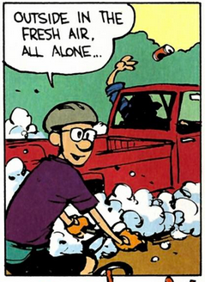

Boolean Operations: OR
= FALSE
OR
FALSE
FALSE
OR Operation
Both input values must be FALSE for output to be FALSE
If Michael likes traffic OR if Michael takes the train to work every day ☹. 🡪 False or False = False
Both inputs must be FALSE for an OR expression to be FALSE.
If Michael is to change his habits and use public transit 🡪 expression becomes true. (One true is enough)

Slide 66

Boolean Operations: OR Gate
Truth Table
Inputs Outputs
0 0 0
0 1 1 0 = FALSE
1 0 1 1 = TRUE
1 1 1
OR Operation
At least one input value must be TRUE for output to be TRUE
0
0
0
0
1
1
1
1
0
1
1
1

Slide 67
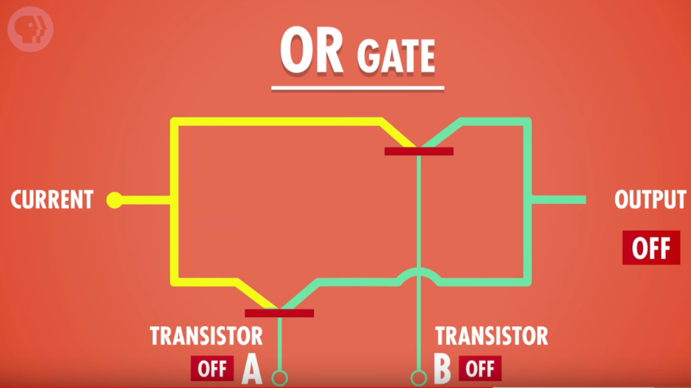
OR Gate
Two inputs (transistors A and B) and one output.
Transistor A: Off (False)
Transistor B: Off (False)
Output: Off (False)

Slide 68
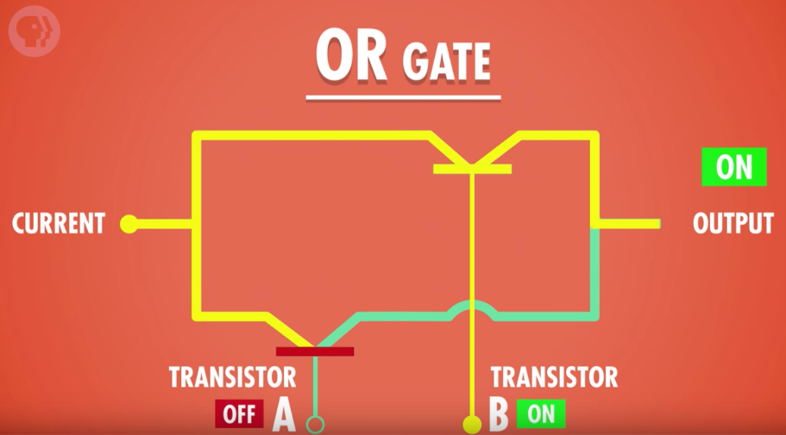
OR Gate
Two inputs (transistors A and B) and one output
Transistor A: Off (False)
Transistor B: On (True)
Output: On (True)

Slide 69

Boolean Operations: NOT
Truth Table
Inputs Outputs
0 1 0 = FALSE
1 0 1 = TRUE
NOT Operation
Only one input
Opposite of input (inverts input)
NOT FALSE = TRUE
NOT TRUE = FALSE
0
1
1
0

Slide 70
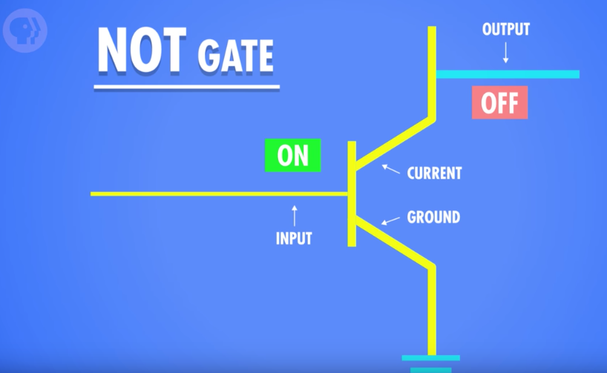
NOT Gate
To build an NOT gate: One transistor
One input and one output
Transistor A: On (True)
Current flows to ground wire and none to output, so output is Off (False)

Slide 71
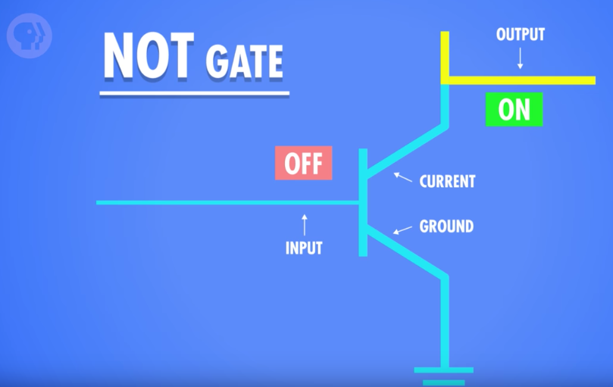
NOT Gate
Transistor A: Off (False)
Current flows to the output wire, so output is On (True)

Slide 72
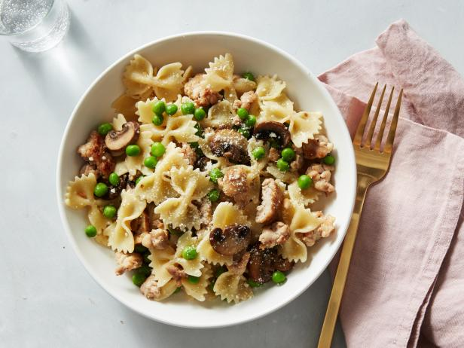

Boolean Operations: XOR
TRUE
FALSE
OR
=TRUE
XOR Operation (Exclusive OR)
One and ONLY one input value can be TRUE for output to be TRUE
At noon Michael is going for lunch XOR Michael is going to class
If both were true, the output would be false! (as I cannot do both at the same time).
If both were false, the output will still be false

Slide 73

Boolean Operations: XOR Gate
0
Truth Table
Inputs Outputs
0 0 0
0 1 1 0 = FALSE
1 0 1 1 = TRUE
1 1 0
XOR Operation
Only one input value is TRUE for output to be TRUE
0
0
0
1
1
1
1
0
1
0
1

Slide 74
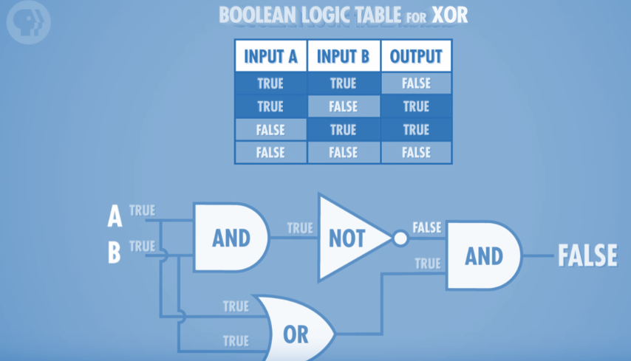
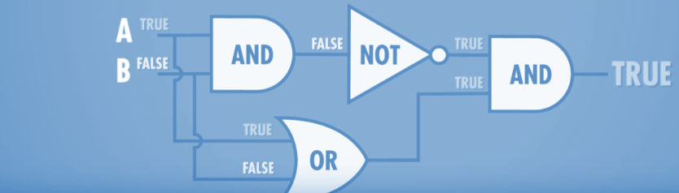
XOR Gate
How to build an XOR gate? We can’t do it directly with transistors-- but we can by combining AND, OR, and NOT gates!
Both of the images above are the same combination of gates; the only difference is the input values

Slide 75
Binary Math with Logic Gates
(or: how does this stuff actually work?)

Slide 76
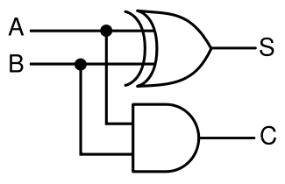
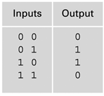
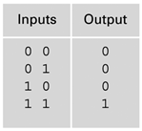
Half Adder Gate: Adding two bits
Inputs: A, B
S = Sum
C = Carry
A + B = 2’s 1’s

Slide 77
Half Adder Gate: Adding two bits
Inputs: A, B
S = Sum
C = Carry
A + B = 2’s 1’s
0 + 0 = 0 0
0 🡪
0
0 🡪
0

Slide 78
Half Adder Gate: Adding two bits
Inputs: A, B
S = Sum
C = Carry
A + B = 2’s 1’s
0 + 1 = 0 1
0 🡪
1
1 🡪
0

Slide 79
Half Adder Gate: Adding two bits
Inputs: A, B
S = Sum
C = Carry
A + B = 2’s 1’s
1 + 0 = 0 1
1 🡪
1
0 🡪
0

Slide 80
Half Adder Gate: Adding two bits
Inputs: A, B
S = Sum
C = Carry
A + B = 2’s 1’s
1 + 1 = 1 0
1 🡪
0
1 🡪
1

Slide 81
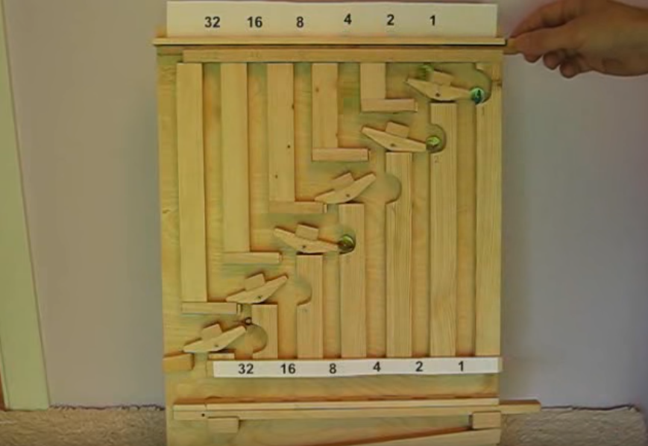
Marble Adding Machine
http://www.youtube.com/watch?v=GcDshWmhF4A&NR=1&feature=fvwp

Slide 82
Hexadecimal Numbers

Slide 83
Hexadecimal Numbers
Hexadecimal number are base 16 numeric system.
Who uses the hexadecimal system?
Web designers.
Digital medial creators.
Computer scientists.
Networking professionals.

Slide 84
Building Hexadecimal Numbers
Decimal | Hex (16’s column) | Hex (1’s column)
0 | 0 | 0
1 | 0 | 1
2 | 0 | 2
3 | 0 | 3
4 | 0 | 4
5 | 0 | 5
6 | 0 | 6
7 | 0 | 7
8 | 0 | 8
everything is the same so far...

Slide 85
Building Hexadecimal Numbers
Decimal | Hex (16’s column) | Hex (1’s column)
9 | 0 | 9
10 | 0 | A
11 | 0 | B
12 | 0 | C
13 | 0 | D
14 | 0 | E
15 | 0 | F
16 | 1 | 0
17 | 1 | 1
here is where it gets interesting!

Slide 86
Building Hexadecimal Numbers
Decimal | Hex (16’s column) | Hex (1’s column)
18 | 1 | 2
19 | 1 | 3
20 | 1 | 4
21 | 1 | 5
22 | 1 | 6
23 | 1 | 7
24 | 1 | 8
25 | 1 | 9
26 | 1 | A
etc. etc.

Slide 87
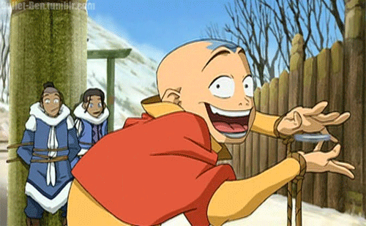
Question
Avatar Aang went to get his first driving license. The clerk asked Aang for his ID to make sure he was old enough to do the driving test. The clerk told him that he needs to be at least 18. Aang answered, “I’m sorry but you are wrong. I am exactly 18, in decimal. My ID in fact shows my age in Hexadecimal.”
What age is Aang in Hexadecimal (if he is indeed 18 in decimal?)
Decimal 16’s 1’s
18

Slide 88
Question
Avatar Aang went to get his first driving license. The clerk asked Aang for his ID to make sure he was old enough to do the driving test. The clerk told him that he needs to be at least 18. Aang answered, “I’m sorry but you are wrong. I am exactly 18, in decimal. My ID in fact shows my age in Hexadecimal.”
What age is Aang in Hexadecimal (if he is indeed 18 in decimal?)
Decimal 16’s 1’s
18 1 2

Slide 89
Why Hexadecimal?
Hexadecimal is perfect for matching 4 bits.
Every combination of 4 bits can be matched with one hex number.
(why? think of powers of 2! How many symbols are there in hexadecimal, how many bits do you need to represent one hexadecimal digit?)
4 bits can be represented by 1 Hex value
8 bits can be represented by 2 Hex values

Slide 90
Hexadecimal Digits
Dec Hex Binary
0 0 0000
1 1 0001
2 2 0010
3 3 0011
4 4 0100
5 5 0101
6 6 0110
7 7 0111
Dec Hex Binary
8 8 1000
9 9 1001
10 A 1010
11 B 1011
12 C 1100
13 D 1101
14 E 1110
15 F 1111

Slide 91
What about 8 bits?
Dec. Hex. Binary Dec. Hex. Binary
0 0 0000 8 8 1000
1 1 0001 9 9 1001
2 2 0010 10 A 1010
3 3 0011 11 B 1011
4 4 0100 12 C 1100
5 5 0101 13 D 1101
6 6 0110 14 E 1110
7 7 0111 15 F 1111
-----------------------------------------------------
HEX BINARY
2 4 ?

Slide 92
What about 8 bits?
Dec. Hex. Binary Dec. Hex. Binary
0 0 0000 8 8 1000
1 1 0001 9 9 1001
2 2 0010 10 A 1010
3 3 0011 11 B 1011
4 4 0100 12 C 1100
5 5 0101 13 D 1101
6 6 0110 14 E 1110
7 7 0111 15 F 1111
-----------------------------------------------------
HEX BINARY
2 4 0010 0100

Slide 93
Using Hex for 8 bits
Dec. Hex. Binary Dec. Hex. Binary
0 0 0000 8 8 1000
1 1 0001 9 9 1001
2 2 0010 10 A 1010
3 3 0011 11 B 1011
4 4 0100 12 C 1100
5 5 0101 13 D 1101
6 6 0110 14 E 1110
7 7 0111 15 F 1111
-----------------------------------------------------
Hex Binary Hex Binary Hex Binary
12 0001 0010 3C 0011 1100 99 1001 1001
Exercise: Convert the following 8 bit (1 byte) hexadecimal numbers to binary
AB 1A 00
02 B4 7D

Slide 94
Hexadecimal # RED GREEN BLUE
<td rowspan="2" bgcolor="#cccc99"> </td>
Red Green Blue
cc cc 99
Convert to Binary
Red Green Blue
Hex cc cc 99
Bin 1100 1100 1100 1100 1001 1001
24 bits represent a single color

Slide 95
Q & A
Notes:
In Slide Show mode, click the arrow to enter the PowerPoint Getting Started Center.

